Slide 1


The Basics of Caregiving
By Caregiver Support program
at the Senior Source

Slide 2
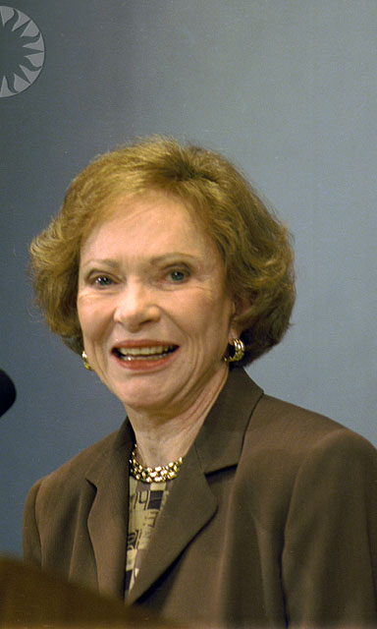

What is a caregiver?
“There are four types of people in the world: those who have been caregivers, those who are currently caregivers, those who will be caregivers, and those who will need caregivers”
Rosalynn Carter
MAKING OLDER BETTER
2

Slide 3
TYPES OF CAREGIVERS
Formal Private Caregivers
Informal family, friends, neighbors, and religious communities

Slide 4

CAREGIVER PROFILE
75% of caregivers are females that spend about 50% of their time caring for a loved one
The average age of a caregiver is 49.2 years old
34% are 65 years or older
Older caregivers are more likely to care for a spouse: the average age is 62 years old

Slide 5
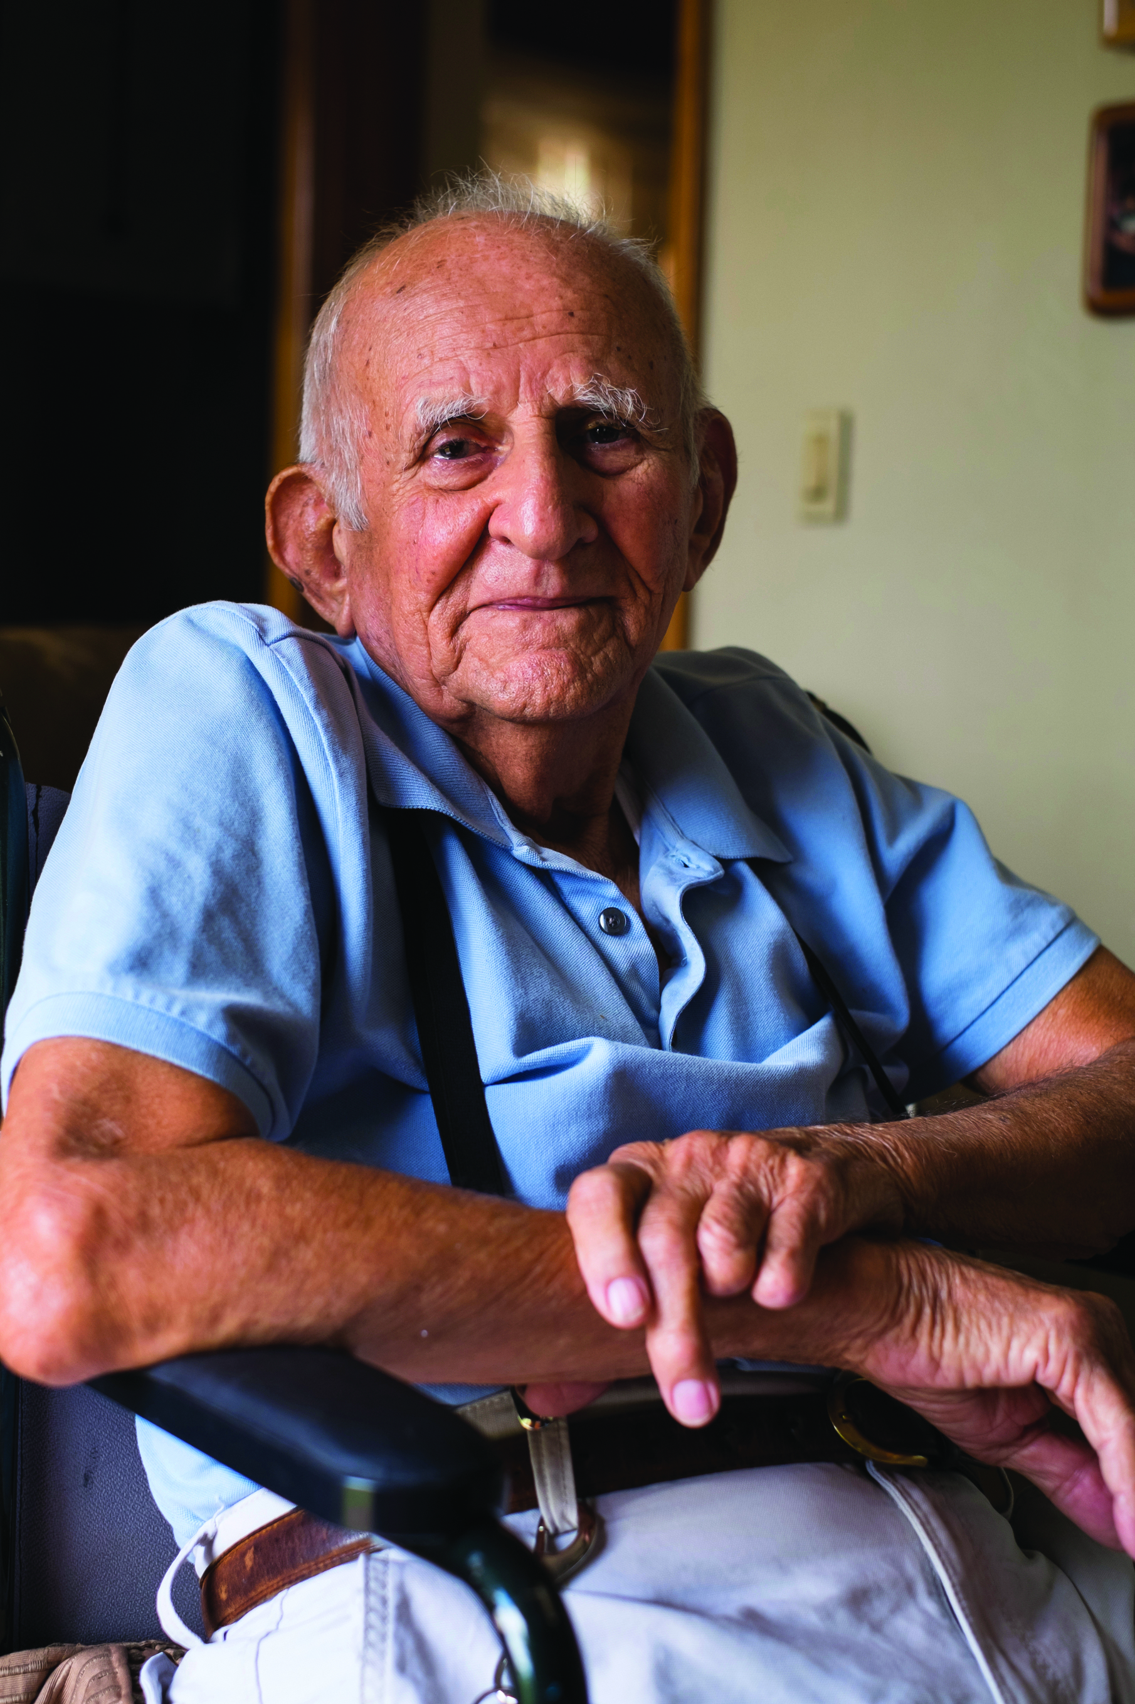
The Economics of caregiving
43.5 million caregivers provided unpaid care to an adult or child in the last year
About 34.2 million caregivers provided care to someone in the last year that was 50 years or older
Unpaid/Informal care has steadily increased over the past decade amounting to an economical value of 470 billion in 2013
The value of unpaid care provided to someone with Alzheimer’s/Dementia is estimated at 217 billion
MAKING OLDER BETTER
5

Slide 7
Activities of Daily Living &
Instrumental Activities of Daily Living
ADLS
IADLS
Dressing
Feeding
Toileting
Bathing
Cooking
Cleaning
Handling Finances
Driving

Slide 8

Caregiver Health
Providing care for loved ones that are chronically ill can have extreme effects physically, mentally and emotionally
It is common that people tend to neglect themselves when caring for others, because of this caregiver health is steadily become a public health issue
MAKING OLDER BETTER
8

Slide 9




Effects on Caregiver Health
Caregivers suffer from higher levels of depression (40-70%) stress and frustration. Stressful situations may lead to harmful behaviors
They have higher rates of physical ailments like heart disease
For female caregivers specifically, higher levels of depression and anxiety symptoms and lower levels of subjective well being like life satisfaction and physical health
Dramatic increase of mental health consequences among women who provide 36 or more hours per week of care to a spouse

Slide 10




Effects on Caregiver Health
Elderly spousal caregivers (aged 66-96) who experience caregiving-related stress have a 63% higher mortality rate than non-caregivers of the same age
Spousal caregivers who provide 36 or more hours per week of care are slightly more likely to smoke and consume more saturated fat
Compared to non-caregivers, female caregivers are twice as likely to not fill a prescription because of the cost (26% vs. 13%)
Caregivers’ self care suffers because they lack the time and energy to prepare proper meals or to exercise. About 6 in 10 caregivers in a national survey reported that their eating (63%) and their exercise habits (58%) are worse than before

Slide 11



WHAT IS SELF CARE?
Self Care is the practice of taking action to improve one's own health by protecting one’s own well-being and happiness during periods of stress.
It is proven that Caregivers have lower rates of practicing self care or engage in preventative health behaviors.
An estimated 72% of Caregivers report not going to doctors appointments as often as they should and 55% miss their appointments

Slide 12
How to apply self care
TAKE
Caregivers must take care of themselves in order to take care of others
Caregivers must recognize their need to care for themselves and engage in holistic activities
Holistic activities can include anything that has a positive effect mentally, physically and emotionally
RECOGNIZE
INCLUDE

Slide 13
Self Care Activities
Music
Writing
Medical appointments
Social Activities
Exercise
Hobbies
Meditation
Respite

Slide 14
Meditation
Take a minimum of 5 minutes a day to relax and release
2 minute exercise https://www.youtube.com/watch?v=CAlWKqZLC4Y

Slide 15

Improving Caregiver Outcomes
Policy makers need to make a dedicated effort to address the impending crisis on caregivers and the aging population to initiate change that is impactful from a financial and resource driven standpoint
Medical professionals must recognize the signs, communicate with patients and caregivers and refer accordingly
MAKING OLDER BETTER
15

Slide 16
Improving Caregiver Outcomes
Increasing
appropriate mental health services and medical care for family caregivers are important steps towards addressing caregiver health
family caregivers healthy and able to provide care is key to maintaining our nation’s long-term care system and, with the increase in the aging population, this issue will only grow more important in the coming decades
Keeping

Slide 17
Improving Caregiver Outcomes
An assessment of family caregiver needs that lead to a care plan with support services
Caregiver education and support programs
Respite to reduce caregiver burden
Financial support to alleviate the economic stress of caregiving
Primary care interventions that address caregiver needs

Slide 18
How can the Caregiver support program help you?
Provides Information & Resources to help caregivers
Provides Supportive Counseling
Attend our Support Group for Caregivers
Sets up a Care Coordination Meeting with families
Attend our Caregiving with Confidence Seminars

Slide 19

Family Caregiving Alliance
https://www.caregiver.org/caregiver-statistics-work-and-caregiving
https://www.caregiver.org/caregiver-statistics-demographics
https://www.caregiver.org/caregiver-health

