Slide 1


Having the “TALK” with Senior Adults
By: The Caregiver Support Group

Slide 2
The Senior Source…Making older better since 1961
ASSIST
PROTECT
CONNECT
  Caregiver Support Program​
  Eldercare Partners​
  Senior Companion Program​
  Elder Financial Safety Center​
  Guardianship Program​
  Long-Term Care Ombudsman Program ​
  AGE (Advocacy Group for Elders)​
  Foster Grandparent Program​
  RSVP

Slide 3

The Caregiver Support Program
Providing information and connecting with resources in the community to help in the caregiving journey
Educational seminars/training: Caregiving with Confidence and Dementia Live Training
Support Group: monthly group with helpful tips and tricks for caregiving situations
Supportive counseling and guidance
Incontinence/DME Assistance

Slide 4
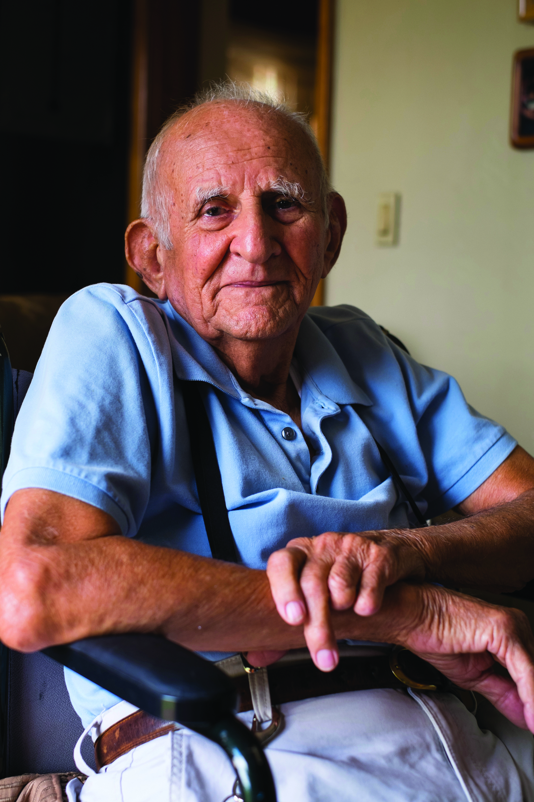

OVERVIEW
Assistance in the home or going into a facility?
Is it time to pump the brakes on driving?
Safety Issues: Assessing your loved ones needs
End of Life Choices
Questions?
MAKING OLDER BETTER
4

Slide 5

Assistance in the home or going into a facility?

Slide 6

Assistance in the home or going into a facility?
The ideal scenario of any older adult is to “Age in Place” in their own home.
There are a couple different factors to consider if your loved one is capable of aging in place.
My go to three questions to age in place:
1) Are they financially capable to stay at home?
2) Are they safe in the home?
3) What is their decision and quality of life?

Slide 7


Determining Capabilities
Activities of Daily Living (ADLS)
Dressing
Feeding
Toileting
Bathing
Instrumental Activities of Daily Living (IADLS)
Cooking
Cleaning
Handling Finances
Driving

Slide 8

Assistance in the Home Options
Different Programs to help “Age in Place”
Senior Companion Program
Meals on Wheels
Grocery delivery
MyRideDallas
Respite
Home Health
Texas Ramp Project

Slide 9
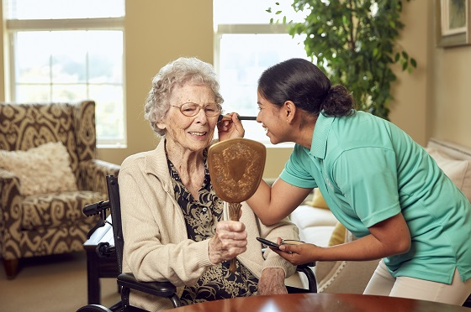
Facility Living Options
Different types of Facilities:
Independent Living
Assisted Living
Memory Care
Long-Term Care(LTC) or Skilled Nursing Facility(SNF)
Continuing Care Retirement Communities(CCRC)

Slide 10

Is it Time to Pump the Brakes on Driving?

Slide 11

What are the warning signs that may indicate your loved one is at risk?
Health(medication changes)
Getting lost in areas they know
Moving into other lanes
Dents/bumps on their car
Forgetting to renew registration sticker or driver’s license

Slide 12
How do you think your loved one will feel about being unable to drive?
Angry
Feel like a burden
Frustrated
They may feel…
Isolated
Depressed
Limited to engage with others

Slide 13

How to have the conversation?
Normalize that this conversation is not easy. It most likely will be a negative conversation.
Take into consideration: They are upset about the message not the messenger.
Have alternative driving suggestions prepared prior to conversation.
Ask how they are feeling about driving? Instead of starting the conversation by “You should stop driving…” It is all about delivery.

Slide 14

How to help guide you through these conversations:
Check out AARP’s learning module for having discussion about driving.
https://www.aarp.org/auto/driver-safety/we-need-to-talk/

Slide 15
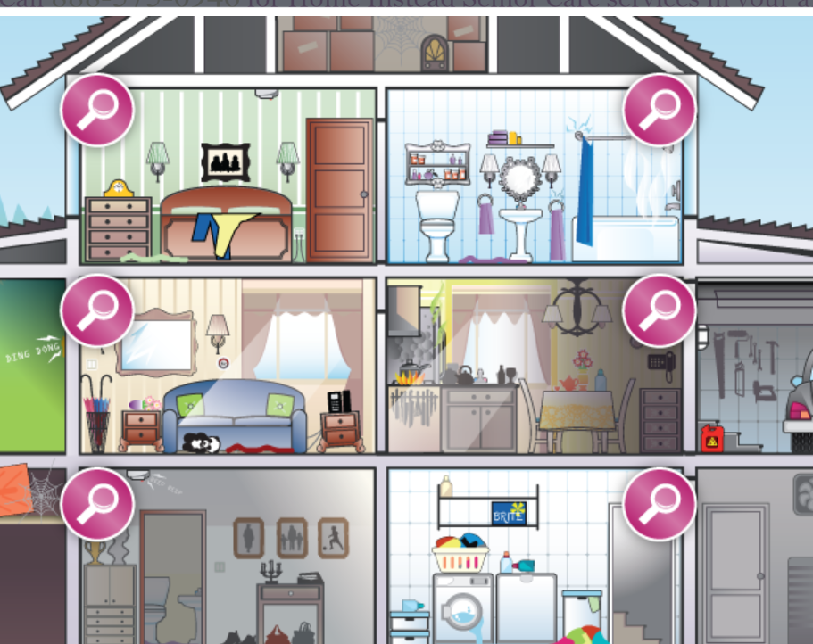
Safety Issues: Assessing your loved one needs

Slide 16




Stairs
Physicians say that injuries are most likely to happen in these areas of the home.
Which one do you think is the highest?
Kitchen
Bedroom
Bathroom

Slide 17
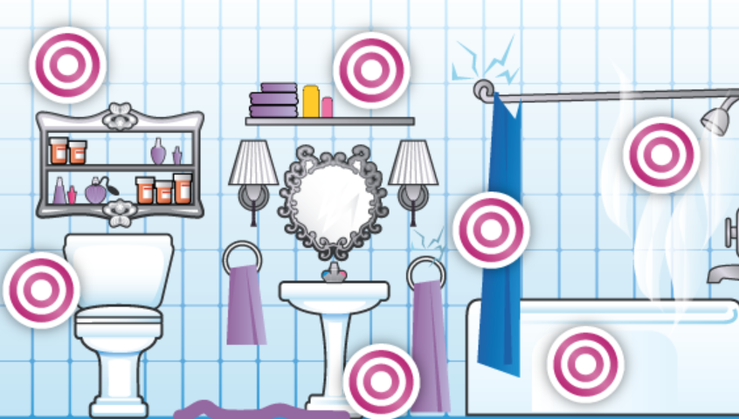
Bathroom
Hazards:
Toilet correct height?
Bathtub too high?
Grab bars in shower?
Height of items?
Medications expired?
Nonslip mats?
Towel rack close to shower?

Slide 18
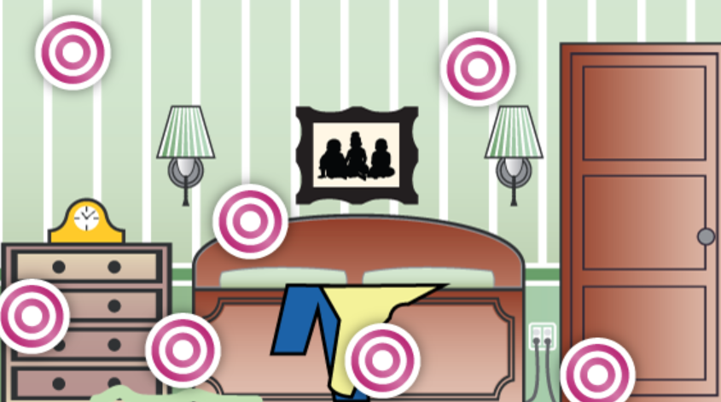
Bedroom
Hazards:
Cords(lamps, alarm clocks, etc) on the floor?
Clutter in the room?
Well lit room?
Bathroom close by?
Phone accessible in room?

Slide 19
Kitchen
Hazards:
Leaving stove on?
Emergency contact list accessible?
Spoiled food in fridge?
Expired food in pantry?
Enough room for chairs?
Chemicals stored safely?
Cabinets too high?

Slide 20

Takeaways: Home Safety
Utilize a home safety checklist
To assess your loved one’s living situation utilize a home safety checklist and make adaptions accordingly
Include your older adult in modifications as a goal to keep them independent as possible

Slide 21

End of Life Choices

Slide 22
End of Life Choices
End of life choices are a very personal matter and a difficult conversation to talk about with older adults
More than 90 percent of people think that it is important to have conversations about
end-of-life care with their loved ones, yet less than 30 percent have done so -AARP
Similarly, 70 percent of people say they want to die at home, but in reality, 70 percent die in hospitals or institutions
-AARP

Slide 23
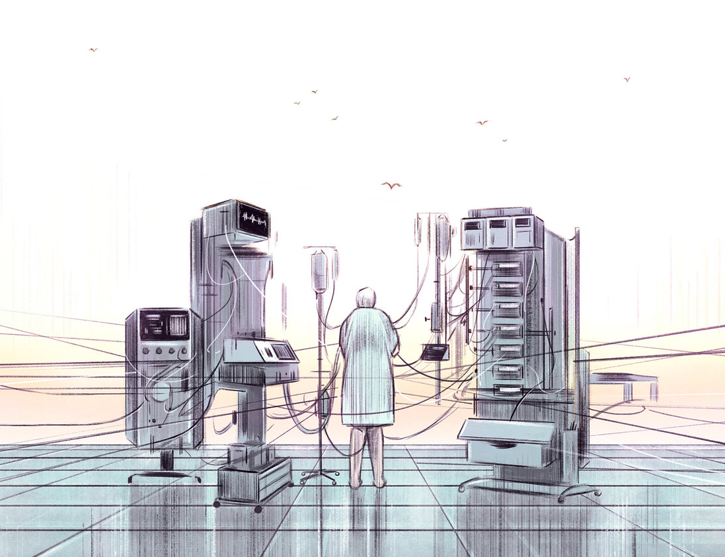
End of Life Choices
Helen was living out the fate of millions of Americans who don't clearly state their medical wishes with an advance directive. Only about a quarter of American adults have an advance directive, according to a 2014 study published in the American Journal of Preventive Medicine -NPR

Slide 24

End of Life Choices
We all die, so why don’t we die well?
–Dr. Atul Gawande
https://www.youtube.com/watch?v=K1Rsk-3mVKs

Slide 25

End of Life Choices
Documents to help:
OOHDNR
MPOA/POA
Directive to Physicians
Advance Directives
Declaration of Mental Health Treatment
Forms can be found on TX Health and Human Services: https://hhs.texas.gov/laws-regulations/forms/advance-directives

Slide 26
End of Life Choices
Arrangements:
Burial: Casket, Veteran burial, or Green Burial
Cremation: Urn, Locket, Tree, or Coral Reef
Donation to Science(Medical Schools)

Slide 27
Questions?

